Slide 1

BIGTECHCOMPANY
Financial Overview

Slide 2
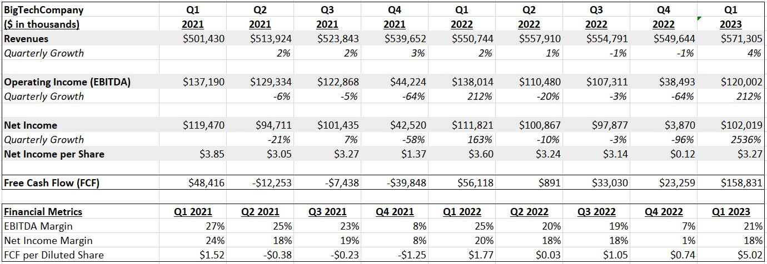
QUARTERLY PERFORMANCE

Slide 3
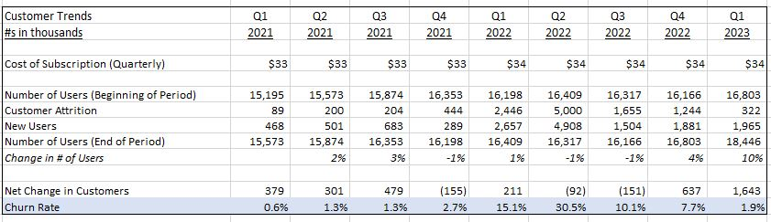
CUSTOMER TRENDS
Key Takeaways:
The churn rate increased from 2.7% in Q4 2021 to 15.1% in Q1 2022, indicating that a significant number of customers left after the price adjustment.
In-depth analysis suggests that the significant increase in the churn rate may be attributed to the rising cost of subscription. Therefore, the price appears to be a sensitive factor influencing customer retention.
he number of users has increased steadily, with a 10% growth in Q1 2023. This suggests a positive trajectory, but attention should be paid to the factors influencing the net change, such as customer acquisition and attrition.

Slide 4
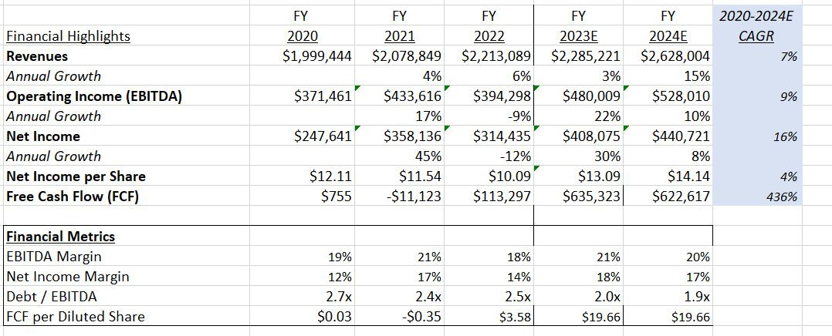
PROJECTIONS

Slide 5
CONCLUSIONS
Company Highlights
Revenues have shown consistent growth, with a CAGR of 7%
The EBITDA Margin has remained relatively stable around 20%.
Free Cash Flow has increased significantly, indicating improved financial health.
Areas of Concern
EBITA and net income have exhibited volatility with a notable drop in Q4 2021 due the increased cost of revenue.
The churn rate increased from 2.7% in Q4 2021 to 15.1% in Q1 2022, indicating that a significant number of customers left after the price adjustment.
Overall, the financial performance of BigTechCompany appears to be dynamic, with fluctuations in key metrics.
Recommendation
Investigate the factors contributing to the high churn rate, particularly after the price increase. Consider customer feedback and implement strategies to enhance customer satisfaction.
Monitor and address any fluctuations in Free Cash Flow to ensure sustainable financial operations.
Continue efforts to acquire new customers and retain existing ones to support the positive trend in customer numbers.

